Slide 1
Support Vector Machine

Slide 2
Introduction
It is a supervised machine learning algorithm
It is mostly used for classification
introduced by B.E. Boser et al. in 1992 & become popular due to success in handwritten digit recognition in 1994
Example: text classification, image classification, spam detection, handwriting identification, gene expression analysis, face detection, and anomaly detection

Slide 3
Terminologies used in SVM
Support vector
The vector points closest to the hyperplane
SVMs are named after these support vectors
Hyperplane
In SVM, the hyperplane is the decision boundary in the feature space
The dimension of the hyperplane depends upon the number of features
If the number of input features is two, then the hyperplane is just a line
If the number of input features is three, then the hyperplane becomes a 2-D plane

Slide 4
Margin
it is the distance between the hyperplane and the observations closest to the hyperplane (support vectors)
In SVM large margin is considered a good margin
Hard Margin
If the training data is linearly separable,
  we can select two parallel hyperplanes that separate the two classes of data
  so that the distance between them is as large as possible

Slide 5
Soft Margin
As most of the real-world data are not fully linearly separable
  we will allow some margin violation to occur
  It is better to have a large margin, even though some constraints are violated
  Margin violation means choosing a hyperplane, which can allow some data points to stay in either the incorrect side of the hyperplane

Slide 6
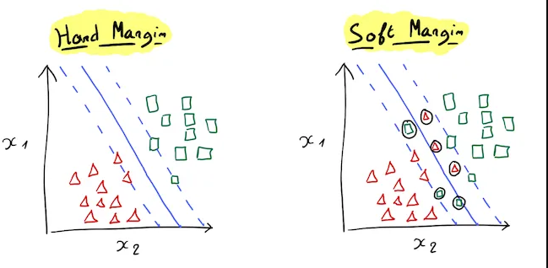

Slide 7
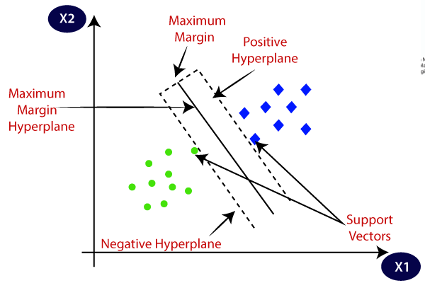
SVM working mechanisms

Slide 8
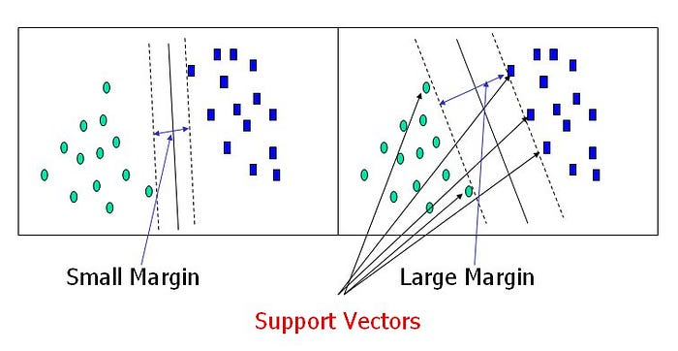

Slide 9
Working mechanism
We draw the 'hyperplane' or decision boundary to classify the data points
The best hyperplane is that plane that has the maximum distance from both the classes
This is done by finding different hyperplanes which is farthest from the data points or the one which has a maximum margin

Slide 10
The hyperplane with farthest distance from support vector is maximum-margin hyperplane/hard margin
The SVM algorithm has the characteristics to ignore the outlier
each time a point crosses the margin, it adds a penalty (soft margin)
Hinge loss is a commonly used penalty (If no violations no hinge loss)

Slide 11
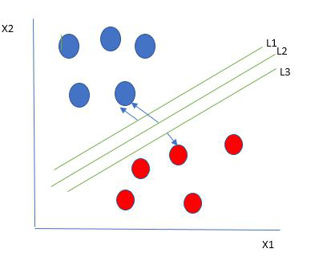

Slide 12
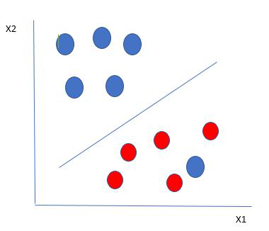

Slide 13
Types of Support Vector Machine
Linear SVM
  use a linear decision boundary to separate the data points of different classes
  a single straight line can entirely divide the data points into their respective classes
Non-Linear SVM
  used to classify data when it cannot be separated into two classes by a straight line
  using kernel functions, nonlinear SVMs can handle nonlinearly separable data (gaussian kernel, sigmoid & polynomial kernel)
  A linear SVM is used to locate a nonlinear decision boundary in this modified space

Slide 14
